Slide 1
LIFE Style
~ SCHOOL LIFE ~
Toki Goto
Yukina Yamamoto

Slide 2
𝐓𝐰𝐨 𝐦𝐚𝐢𝐧 𝐩𝐚𝐫𝐭𝐬
𝟏. 𝐀 𝐝𝐞𝐬𝐜𝐫𝐢𝐩𝐭𝐢𝐨𝐧 𝐨𝐟 𝐬𝐜𝐡𝐨𝐨𝐥 𝐥𝐢𝐟𝐞 𝐢𝐧 𝐀𝐦𝐞𝐫𝐢𝐜𝐚.
𝟐. 𝐓𝐡𝐞 𝐢𝐦𝐩𝐨𝐫𝐭𝐚𝐧𝐜𝐞 𝐨𝐟 𝐬𝐜𝐡𝐨𝐨𝐥 𝐥𝐢𝐟𝐞 𝐢𝐧 𝐀𝐦𝐞𝐫𝐢𝐜𝐚𝐧 𝐜𝐮𝐥𝐭𝐮𝐫𝐞.

Slide 3
• 𝐅𝐈𝐑𝐒𝐓
~𝐀 𝐝𝐞𝐬𝐜𝐫𝐢𝐩𝐭𝐢𝐨𝐧 𝐨𝐟 𝐬𝐜𝐡𝐨𝐨𝐥 𝐥𝐢𝐟𝐞 𝐢𝐧 𝐀𝐦𝐞𝐫𝐢𝐜𝐚~

Slide 4
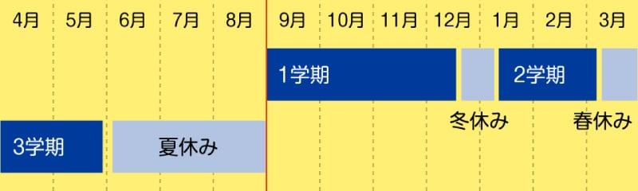
𝐓𝐡𝐞 𝐬𝐭𝐚𝐫𝐭 𝐨𝐟 𝐭𝐡𝐞 𝐬𝐜𝐡𝐨𝐨𝐥 𝐲𝐞𝐚𝐫 𝐢𝐬 𝐚𝐭 𝐝𝐢𝐟𝐟𝐞𝐫𝐞𝐧𝐭
In America

Slide 5
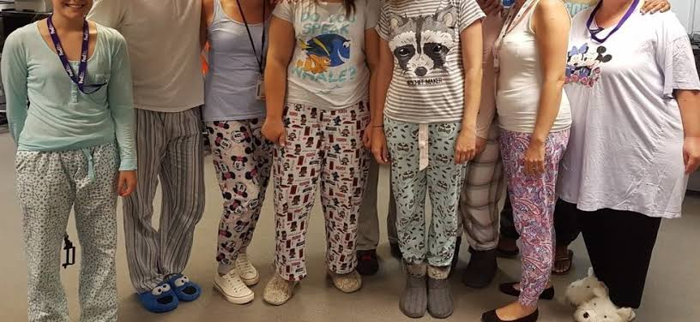
𝐓𝐡𝐞𝐫𝐞 𝐚𝐫𝐞 𝐚 𝐥𝐨𝐭 𝐨𝐟 𝐮𝐧𝐢𝐪𝐮𝐞 𝐞𝐯𝐞𝐧𝐭𝐬 𝐢𝐧 𝐀𝐦𝐞𝐫𝐢𝐜𝐚
〜𝐏𝐀𝐉𝐀𝐌𝐀 𝐃𝐀𝐘〜

Slide 6
2ND MAIN POINT
The importance of high schools in America

Slide 7
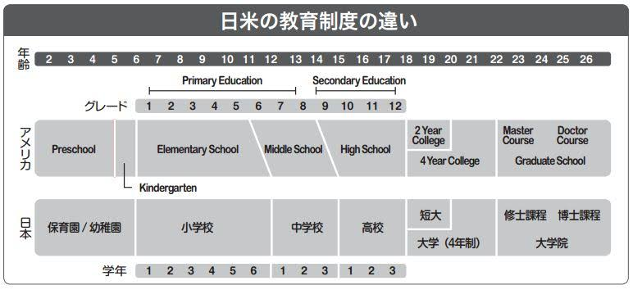
EDUCATION SYSTEM

Slide 8
The difference of roles
<public>
the MINIMUM compulsory education
< private>
COLLEGE-PREPARATORY school

Slide 9
knowing differences
⬇
better understanding
each other’s countries

Slide 10

Thank you very much
for listening !

